Slide 1
SUSTAINABLE
HOSPITALS
LDE Centre for Sustainability
Notes:
Welcome everyone to the presentation of sustainable hospitals. In this lab, we have 10 students with various backgrounds, some from more technological side, some from science, and some from management. Together, we are solving the sustainable challenge of healthcare from distinctive perspectives.

Slide 2
DID YOU KNOW?
Tata Steel and hospitals have one thing in common: their national carbon footprint
Both are responsible for 8% of Dutch CO2 emissions.
Notes:
To begin with, we all know that healthcare is responsible for around 8% of carbon emission in the Netherlands, but how polluting is it? About the same as Tata Steel.

Slide 3
How do you feel about moving towards a sustainable hospital?
Voting code: 4171 1150
https://www.mentimeter.com/app/presentation/alpyq151zufi81h4kfnxg6k33btf5r32
Notes:
We all know the goals of green deal sustainable healthcare, aiming at climate neutral and maximum circularity by 2050.
With these clear targets set ahead and the practice you're doing now, we'd like to know How do you feel about moving towards a sustainable hospital? You scan the code and share your opinions here.
Improvise based on the result

Slide 4
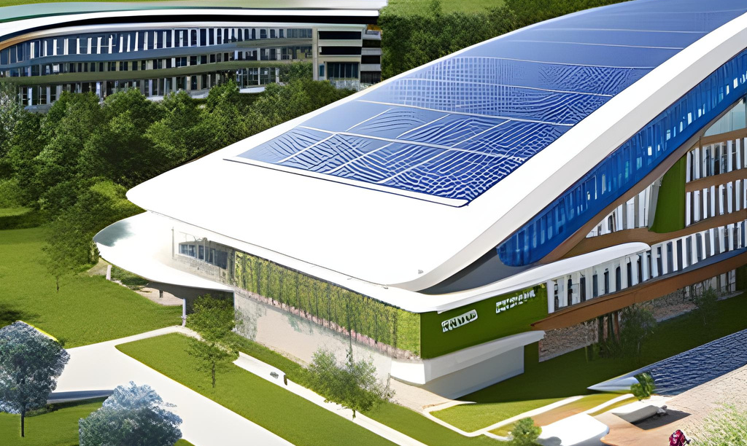
What can hospitals do today to become more sustainable?
Tangible actions
Reusables instead of disposables
Reduce energy use
Better waste management
Stop procedures in OR that can be performed at day care
Steer towards more plant-based food
Notes:
So, What can hospitals do today to become more sustainable?
The foundation of this pathway is Knowledge sharing within and between hospitals.
On top of the knowledge sharing, there are 5 tangible actions that hospital and act today, not tomorrow, to become more sustainable.
Mels will talk more about each individual action.

Slide 5
SWITCH TO REUSABLES
Reusable: lower environmental impact compared to disposables
Medical textiles: Surgical gown
Surgical cap
Cellulose mat
Check out healthcareLCA.com for LCA studies between reusables and disposables
Notes:
The first action that hospitals can take today is to use reusables instead of disposables.
Life Cycle Assessments have shown that, generally, reusables have a lower environmental impact compared to disposables.
One class of reusables are medical textiles. There are multiple LCAs that showed that surgical gowns, surgical caps and other textile products have lower environmental impact than disposables. Reusable cellulose mats, for example, have a two to three times lower environmental impact than disposable mats.
Hospitals should not only switch to reusable textiles but also other reusable medical devices with lower environmental impacts that can be identified at healthcareLCA.com

Slide 6
What barriers do you see on the material logistics infrastructure to move towards reusables?
Menti.com
Voting code: 4171 1150

Slide 7
REUSABLES
Material Logsitics Infrastructure solutions
#1 Track & Trace: unique medical device history
More frequent scanning or RFID/BLE-technology
#2: Storage space: Warehouse Management System
Optimize storage space
Automate the order system
Pick items that expire the earliest first
#3: Reprocessing: improvements at the sterilization department:
Packing robot
RFID-technology on sets/individual instruments
Endoscopic dryer
Rigid sterilization containers or reuse Blue wrap
#4 Transport: Autonomous Mobile Robots (AMR)
Notes:
-From the question:
“What barriers do you see on the material logistics infrastructure to move to reusables?” (slide 6)
, you will probably get answers like:
- Not enough logistics employees
- Not enough (storage) space
- Not enough CSD (central sterilization department) employees
- Not enough CSD space available
Text:
For all these problems there are solution options.
#1. The first and most important solution is to track and trace the history of unique medical devices throughout the hospital, which can bedone through an already existing tool inside ERP or Asset management software. From 2025 onwards all medical devices will have a unique barcode. When this barcode would be scanned more frequently with every movement, reprocess or repair and information about its history is added. You can use this information to implement the other solutions. An other more sophisticated option is to implement RFID or BLE technology which allows for automated tracking and tracing.
#2. The second most important solution is to implement a warehouse management system, that when you know where everything is location because you have implemented a tracking and tracing solution, can help to improve many things including:
- Optimize storage space
- Automate the order system
- Pick items that expire the earliest first
This all not only saves storage space, but also time, logistics employees and spillage (waste).
#3 the third solutions are for the central sterilization department (CSD) and includes:
- Packing robot
o (Save 1 FTE & 10% blue wrap)
- RFID technology on sets/individual instruments
o (Save FTE, because no more scanning required)
- Endoscopic dryer
o (Save space & time, compared to bigger endoscopic drying closets)
- Rigid sterilization container
o (Requires more space, but lower environmental impact compared to blue wrap)
#4 The fourth solution is for replacing logistics employees that transport items throughout the hospital with Autonomous Mobile Robots. One of the requirements for this to work is that you know how much movements they are going to make on different times on the day, which is something the tracking and tracing solutions can help with.

Slide 8
REDUCE ENERGY USE
2
By reducing energy consumption, hospitals can lower greenhouse gas emissions and save costs in the long run.
Transparancy of manufacturer
1
Sustainable setting of medical equipment as default
Notes:
Reducing energy use in hospitals is possible and highly necessary.
- Medical devices often have a stand-by function or some even have an energy saving mode available. E.g. it was found that imaging scanners have an energy saving mode that currently wasn't known and therefore wasn't used. This should be set as the default setting when possible. Sometimes, devices can even be shut down when inactively used. A straightforward example for this are the computers used in the hospitals that can be shut down overnight.
- For this, transparancy from the manufacturer is required about possible energy saving settings of the medical equipment. Pressure from the hospitals can be put on the manufacturer and hospitals can even group together to put more pressure on them. Technological developments make it possible for equipment to automatically switch to a less energy-consuming mode when it is inactively used for a while, this also needs to be implemented in medical equipment from now on.

Slide 9
BETTER WASTE MANAGEMENT
Action points:
Provide accessible distribution bins
Recycle metals and certain thermoplastics
Track & trace waste generation throughout the hospital better
Example of medicine waste: next slide
Notes:
Efficient waste management is essential for hospital sustainability. Strategies include accessible bins for recycling and proper disposal of the employees. For example, metals and thermoplastics can be recycled and transformed into new products. For recycling it is important that medical-contaminated waste stays separate from other waste, because only the non-contaminated waste can be used for recycling methods. Accessible bins and training of the employees

Slide 10
REDUCING MEDICATION WASTE
Notes:
Noor did her thesis on reducing medication waste in the OR
Actionable solutions for this problem are:
1. Creating awareness of the most wasted medications
2. Appropriate prescribing:
- proper dosis calculation with weight and lenght of the procedure in mind
- there are tools available like a calculation table and app to decide on the dose of Propofol
3. Investigate in alternatives:
for example a check valve, prefilled syringes and using smaller sizes of medication.
4. Check for expired medicines in the stock and keep track of them.
5. Proper disposal: discard medicins in the right bin and create a seperate waste stream for mediciation waste.

Slide 11
STOP PERFORMING PROCEDURES
IN THE OR THAT CAN BE PERFORMED AT DAY CARE
Notes:
For example: NovaSure procedure, which is currently performed in the OR. That is not necessary. The NovaSure procedure can be performed in the outpatient care. Right now it is performed at the OR out of ease. As we all know, the use of an OR room has an higher impact on the environment than using the outpatient rooms. For example: ventilation, pressure in the OR room, patients have to wear certain foot coverage (plastic) etc etc.

Slide 12
STEER TOWARDS MORE PLANT-BASED FOOD
Goal: Decrease use of animal proteins to lower GHG emissions of hospitals
Drivers:
Use nudging to encourage transition
Utilise employee training
Gather staff and organisational support
Notes:
In hospital CO2 emissions, around 62% is made up by the supply chain out of which 10% constitute of emissions from catering services. This presents a big potential for lowering emissions. One way in which this can be done is by stimulating plant-based options. A study in the LUMC has shown that this would benefit the majority of patients in the ward and visitor / employee restaurant. Often, budgetary restraints, lack of staff and organisational support as well as a lack of prioritisation were found as barriers against this transition. On the other hand, governmental guidelines, staff training and nudging were found to have a positive effect.
To develop sustainable hospitals, it's important to also encourage a food transition towards a sustainable diet that includes more plant-based foods. Users of the hospital catering services should be encouraged to choose healthy and sustainable food products. This could be achieved with informational campaigns or psychological interventions and adaptations, such as nudging. With nudging, sustainable food choice could be encouraged without changing the price of products or eliminating certain options. Non-intrusive and subtle changes to the environment of hospital restaurants and cafeterias could contribute to behaviour change of hospital staff and visitors. With more investigation, it could be determined whether nudging would also be a suitable strategy for promoting sustainable food choice amongst patients of hospitals.

Slide 13
How do you feel about moving towards a sustainable hospital?
Menti.com
Voting code: 4171 1150

Slide 14
THANK YOU FOR LISTENING!
Any questions?

