Slide 1

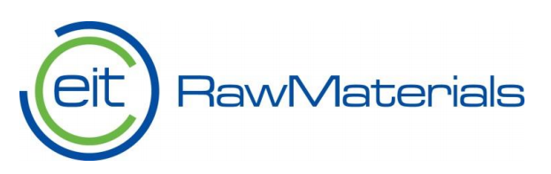
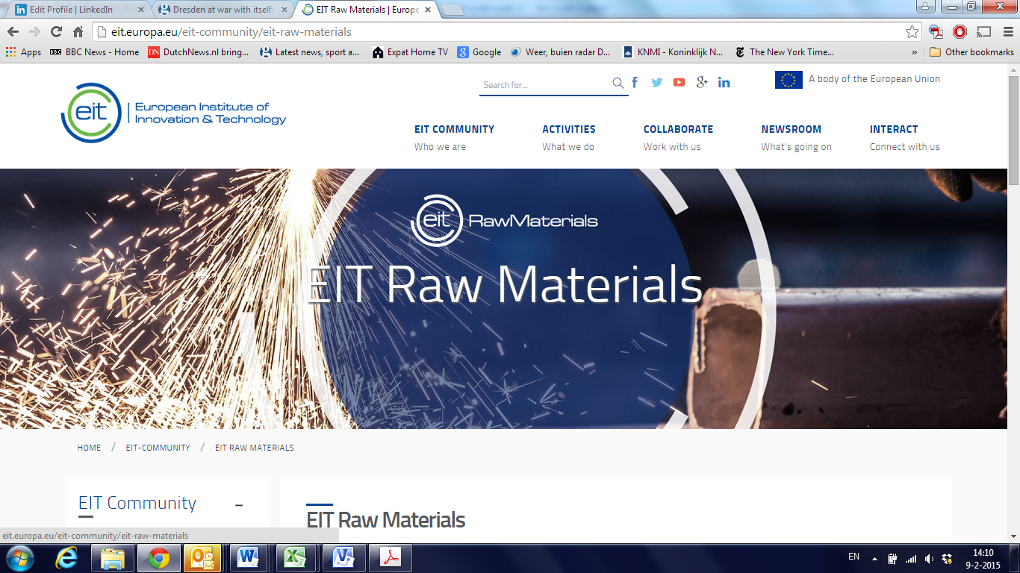



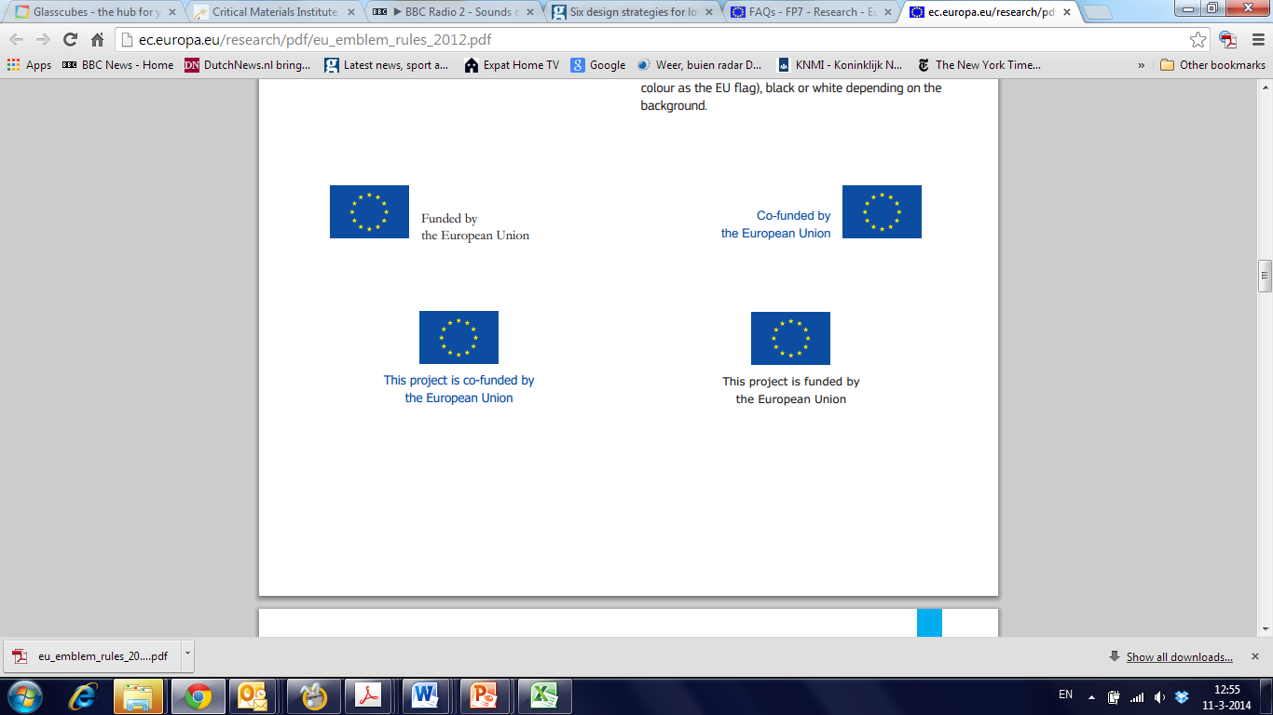
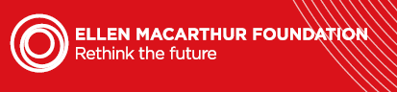
Building a circular
economy: education
David Peck
Senior Research Fellow
Critical Materials and Circular Cities
Architecture and Built Environment
Delft University of Technology

Slide 2

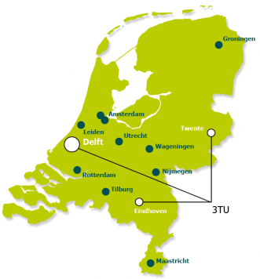
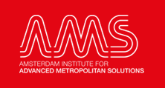
University Landscape
Leiden, Delft, Erasmus
Centre for Sustainability
Amsterdam
Universities of Technology
• Delft
• Eindhoven
• Twente
• Wageningen (agriculture, food tech)
TU Delft, Pioneer University and CE 100 partner

Slide 3
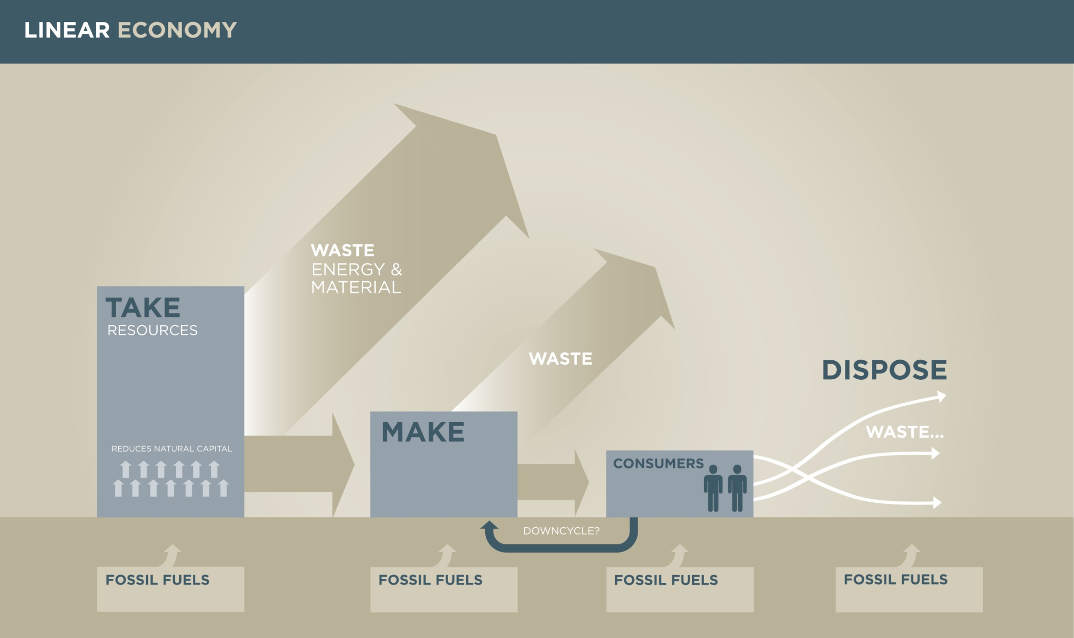


Slide 4
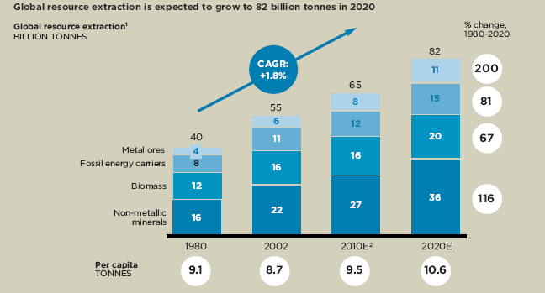

Slide 5
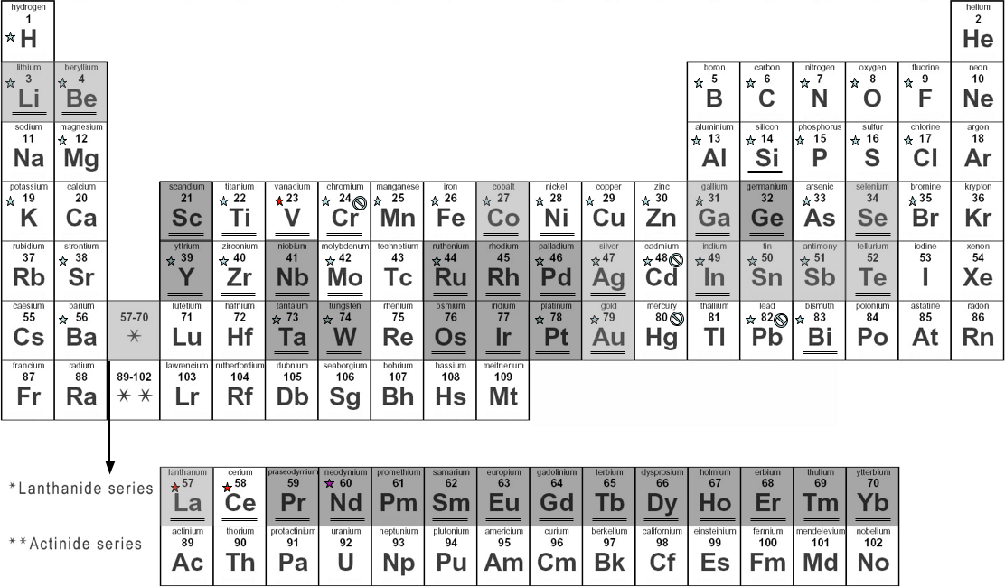
Critical materials are…..
Overview of critical elements
Borates
Magnesite
Silicon metal
Coking coal
Fluorspar
Natural graphite
Phosphate rock
Platinum Group metals*
Light Rare Earths (LREE)
Heavy Rare Earths (HREE)
REPORT ON CRITICAL RAW MATERIALS FOR THE EU
Report of the European Commission and the Ad hoc Working Group on defining critical raw materials and European Commission matter
European Commission May 2014
5

Slide 6
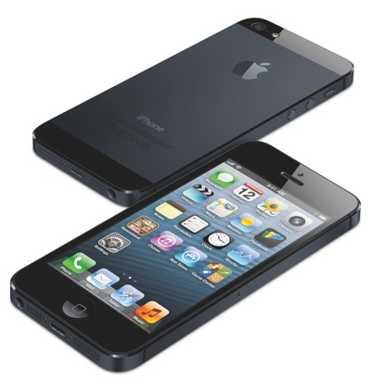

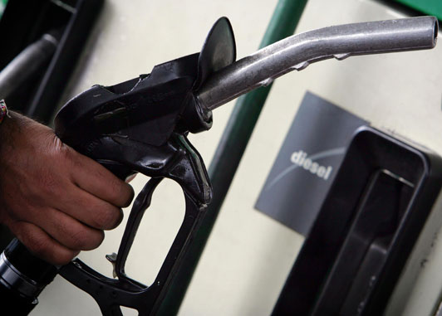
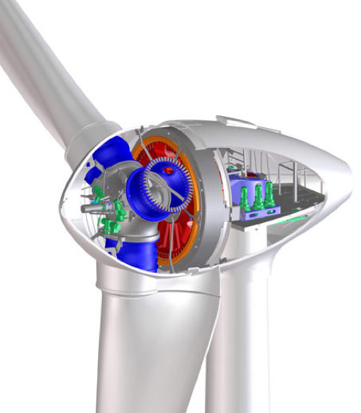


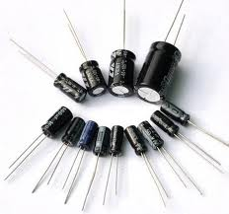
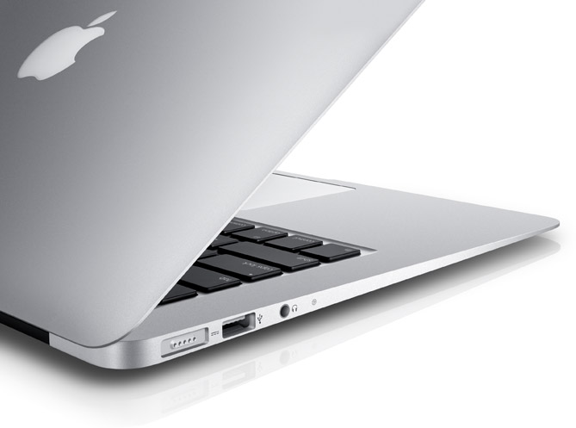
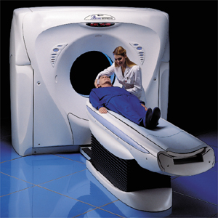
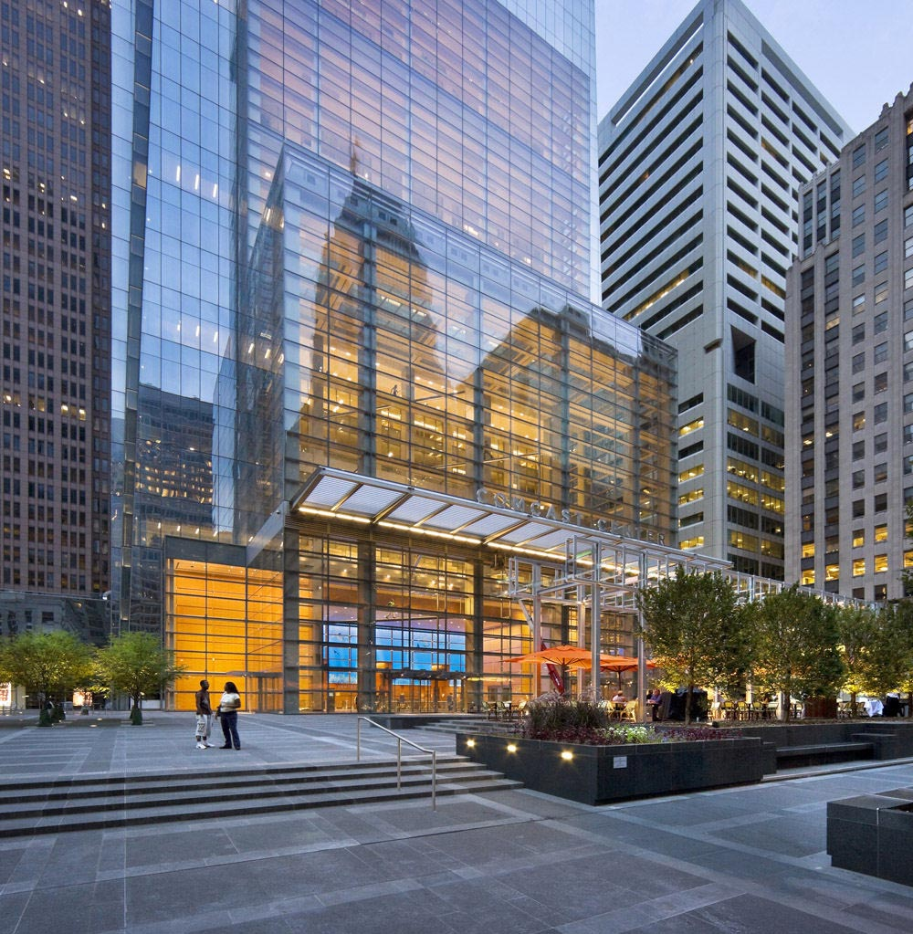

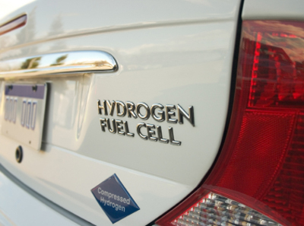
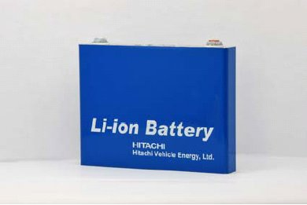
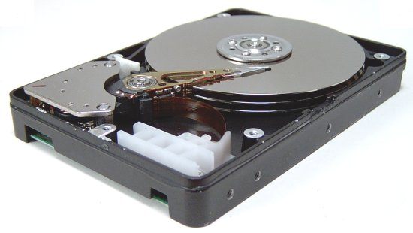

Critical Materials – used in…..

Slide 7
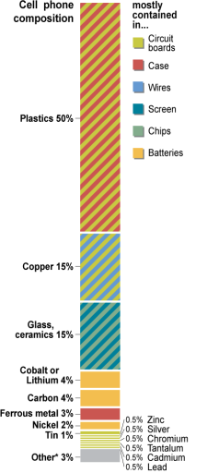
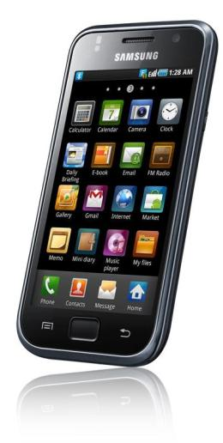

Elements everywhere
Typical elements
H, Li, Be, C, N, O, F, Al, Si, S, Cl, K, Ca, Ti, Cr, Mn, Fe, Co, Ni, Cu, Zn, Ga, As, Br, Sr, Y, Zr, Ru, Pd, Ag, Cd, In, Sn, Sb, Ba, Ta, W, Pt, Au, Hg, Pb, Bi, Nd. + + = 75 elements
mobile phone weighing 100 grams, contains
  13.7 g of copper
  0.189 g of silver
  0.028 g of gold
  0.014 g of palladium
“To put GE’s material usage in perspective, we use at least 70 of the first 83 elements listed in the Periodic Table of Elements”
Duclos, 2010

Slide 8
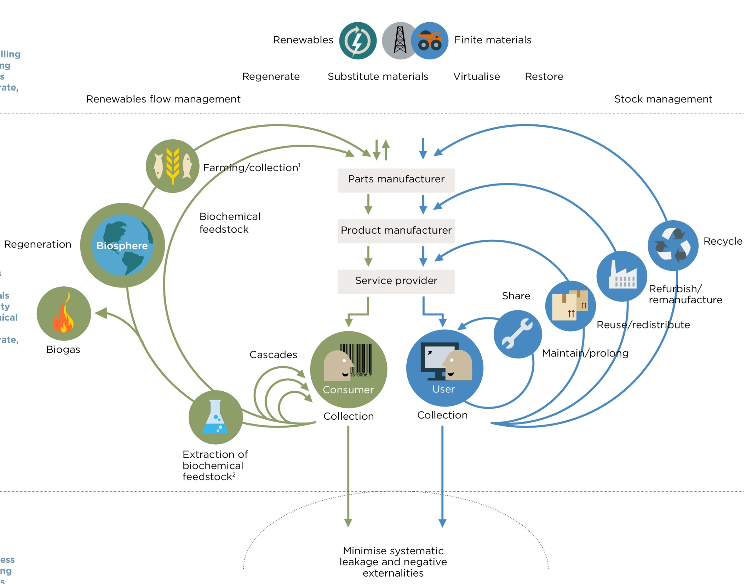

http://www.ellenmacarthurfoundation.org/circular-economy/interactive-diagram
Ellen MacArthur Foundation, Towards the Circular Economy. Economic and business rationale for an accelerated transition (Vol. 1), 2012 Also Vol 2 & 3

Slide 9
S-EMF 2013
Delft University of Technology (Netherlands)
David Peck (mentor)
“….if I’m really honest, I’ve not seen any other credible
solution in Europe that offers a solution space to critical materials. For me the circular economy is the answer on the table at this time.”
Flora Poppelaars (fellow)
“The model is focused on business and how to make it interesting for companies to use it. It seems really possible to make it work and that makes me feel a lot more optimistic about our economy.”

Slide 10
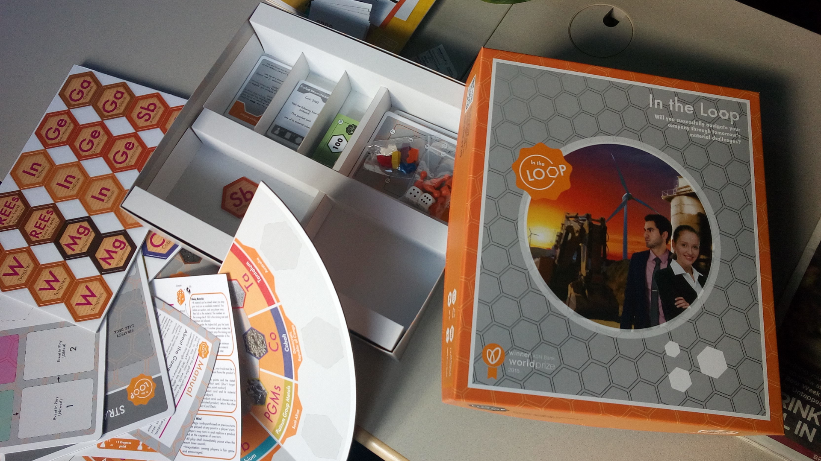
In the Loop game available now….
Katherine Whalen, CEO In the Loop & Lund University.

Slide 11
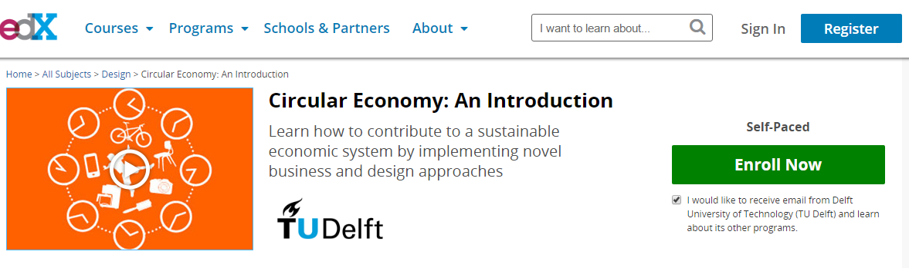


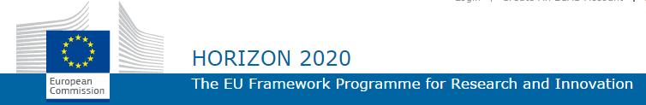
ProSUM - Creating the European knowledge base on secondary sources for Critical Raw Materials.
http://www.remanufacturing.eu/

Slide 12
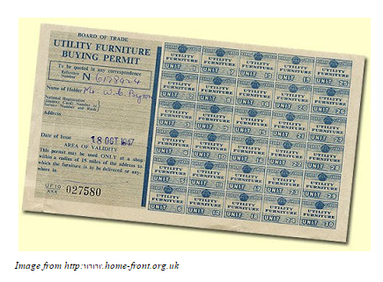

The topic of critical materials is comparatively new. The product design community = not aware + not my problem
History shows that material constraint solutions = new designs.
Design can gain greater societal relevance, power and importance because of it. Put simply material constraint can be a ‘game-changer’ in the field of product design.

Slide 13
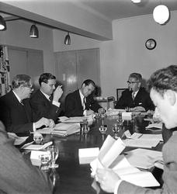
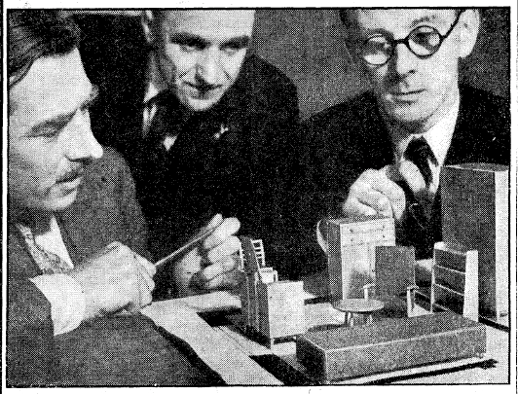
Who (back then) – 1943

Slide 14
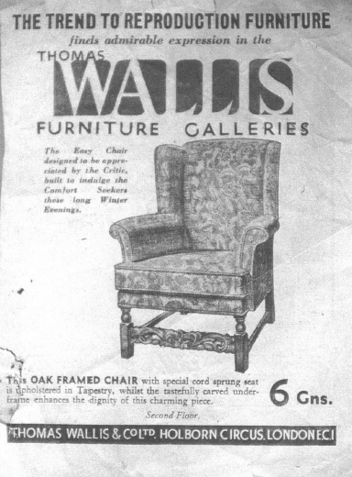
This is pre-war = bad design

Slide 15
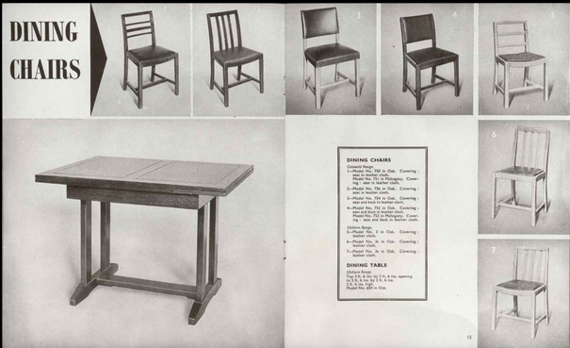
Utility design = good design

Slide 16
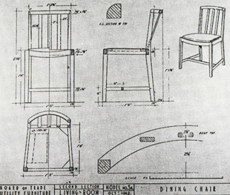
All details compulsory = good design

Slide 17
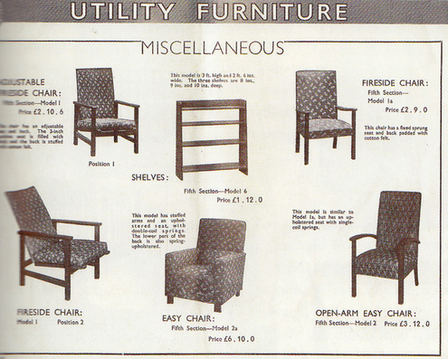
Any reminders here?

Slide 18
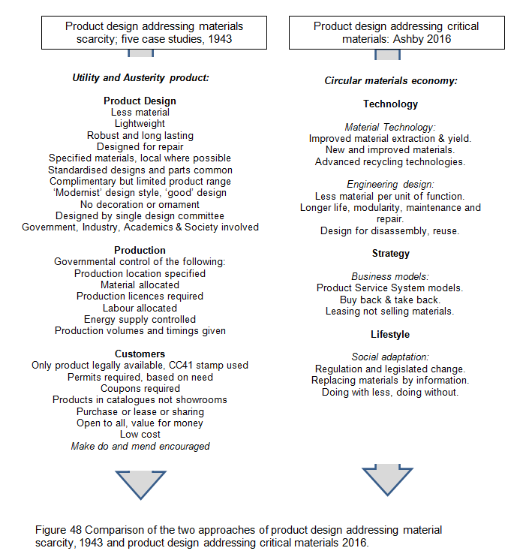
Peck. D, Prometheus Missing: Critical Materials and Product Design, 2016

Slide 19
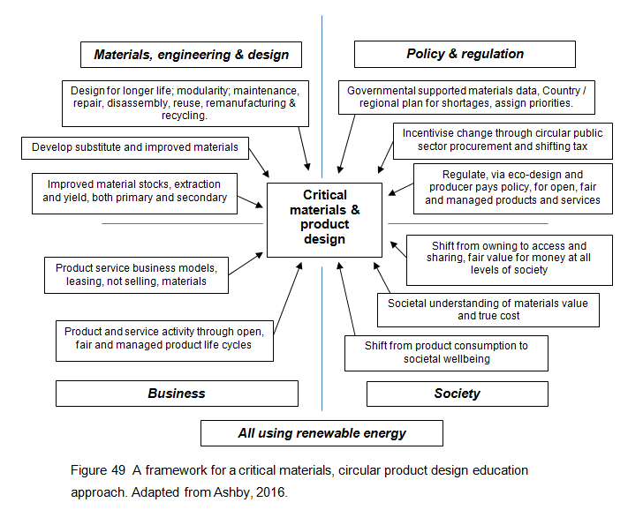
Peck, D, Prometheus Missing: Critical Materials and Product Design, 2016

Slide 20
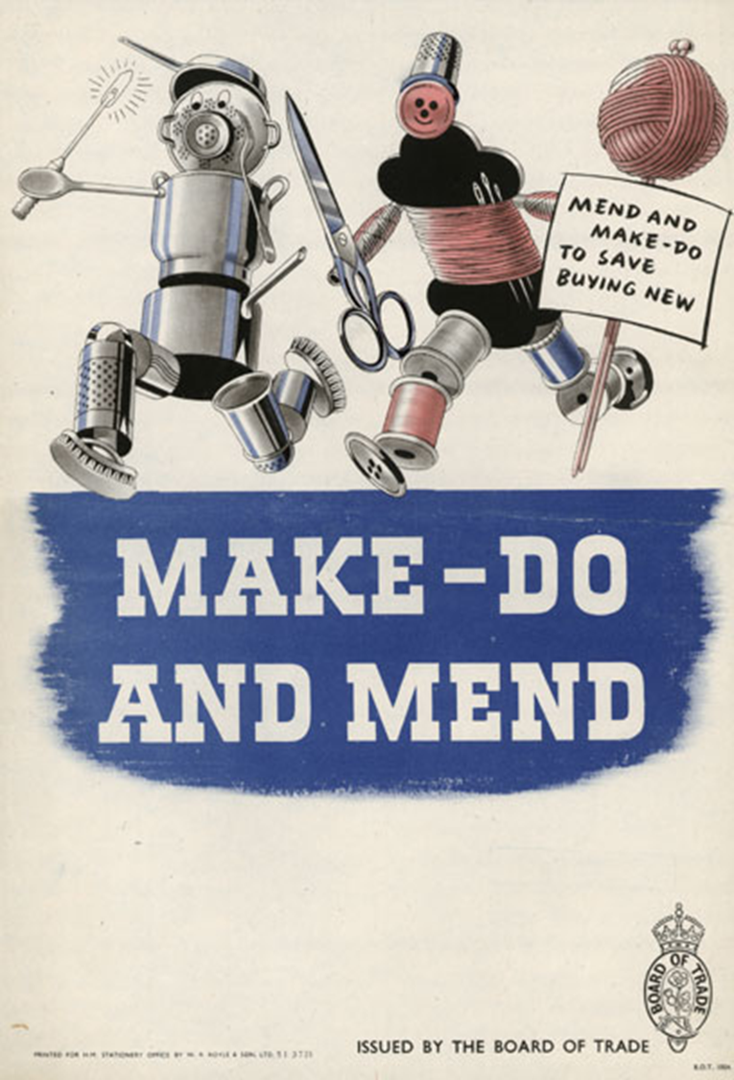

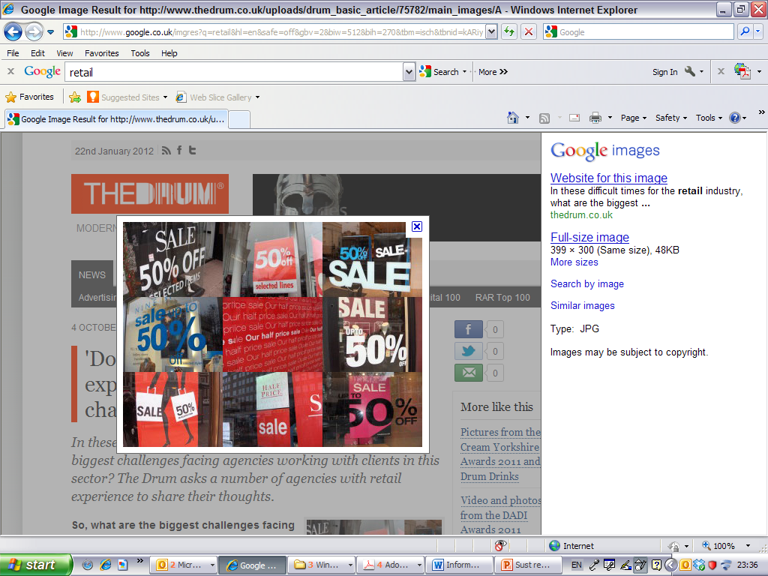
Democracy probably requires relative abundance, not scarcity, in order to thrive.
The circular economy – a wealth of flows, Webster K, 2015
QUESTIONS?

